Slide 1

What a Digital Forensics Investigator Should Know About Steganalysis of Digital Content
Year 3 Computer & network Forensics
Presenter: James Finglas B00094138@student.itb.ie
2018/19

Slide 2
Contents
Introduction
Steganography
Steganography example
Steganalysis
Steganalysis Continued
Steganalysis Continued 2
Steganalysis Continued 3
Conclusion
Contact Info

Slide 3
Introduction
The purpose of todays presentation is to give a brief overview of Steganalysis, and what an investigator should know in order to perform a good analysis of an suspicious file.
We shall consider the different types of steganalysis.
The presentation will touch on different types of steganographic injection and the programs used to achieve it, as well as programs used to detect the stego objects.

Slide 4
Steganography
There are many forms of steganography, such as Least significant bit(LSB), inner and outer loop injection, and manual steganography. Far too many for this presentation to cover. But each type creates a unique signature when used.
There are many programs used to inject the stego objects into carriers files, such as Steghide, Steg’N’Hide, OpenSteg or Rsteg, again the list far exceeds the scope of the presentation. But an investigator should be familiar with as many as possible.

Slide 5
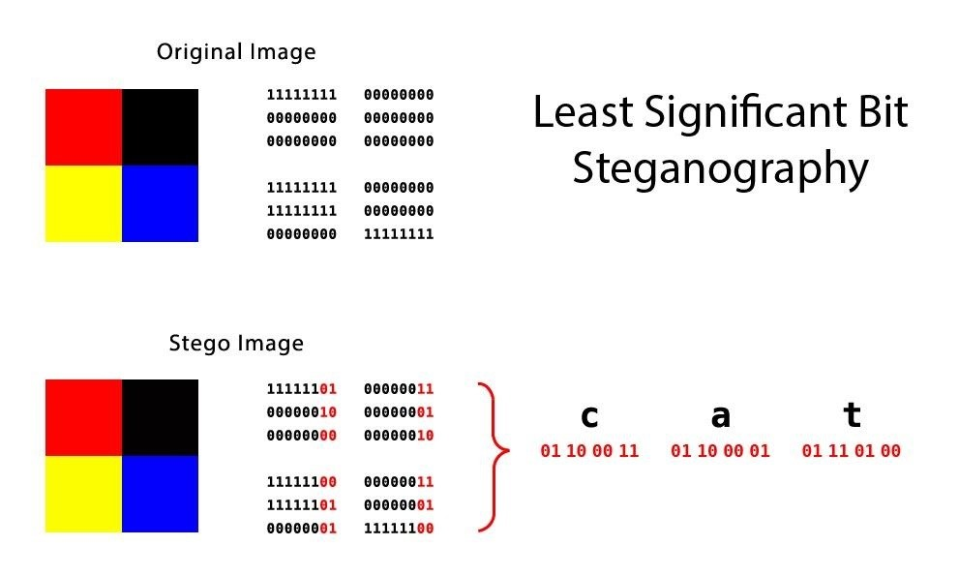
Here we see an example of LSB with the stego text object being appended to the least significant bit through ought the e carrier file.

Slide 6
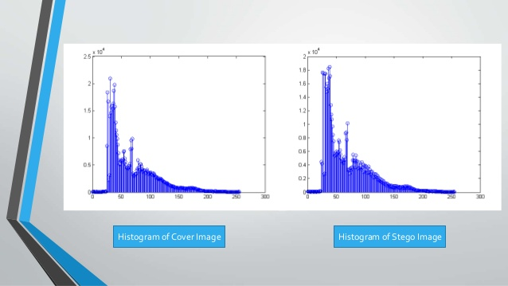
Here we see an example of Histogram comparison

Slide 7
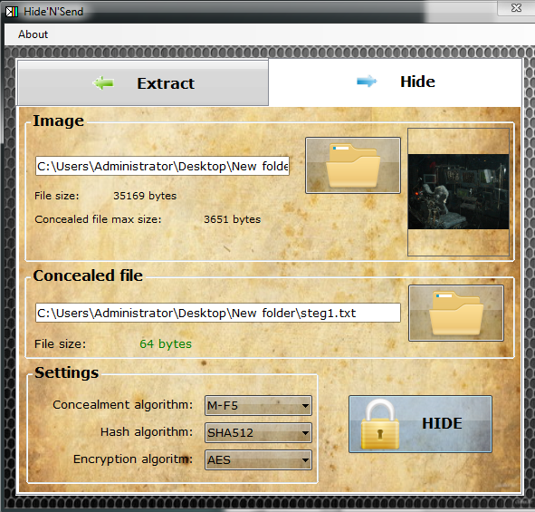
Steganography example
Here we see an example of Steganography being employed via Hide’N’Send.
Notice the algorithm, hash and encryption
options.
This creates a new stego object inside of
the carrier file.

Slide 8
Steganalysis
The are two primary Schools steganalysis. Passive and Active.
Passive is ONLY concerned with detecting the presence of a hidden message and is the more common form.
Active concerns itself with retrieving the stego object, and perhaps altering it to re implant to change its intended use.

Slide 9
Steganalysis Continued
There are two main methods of employing steganalysis
Blind Steganalysis, which can br broken down as follows:
If one employs the Blind method to a Steganalysis of a file this can be further broken down into one of six basic types of Steganalysis attack [6]:
Stego only attack: In this case only the suspect data stream or file object is available for analysis
Known message attack: The original virgin (Pre-Steganography file) carrier file is available as well as the Stego object. A direct comparison can be performed to detect abnormalities.

Slide 10
Steganalysis Continued 2
Known message attack: The hidden message and the corresponding carrier file are known. The type of attack may not seem useful at first hand since everything is provided for a full analysis, however this does help establish known patterns and hashes for future analysis.
Known Stego attack: Both virgin and carrier files are available as well as the type of steganography being known.
Chosen Stego Attack: The Steganography program and carrier file are known.
Chosen Message attack: In this case, the investigator will use Steganographic tools to create Stego objects, to compare the resulting signatures against suspect data streams or carrier files.

Slide 11
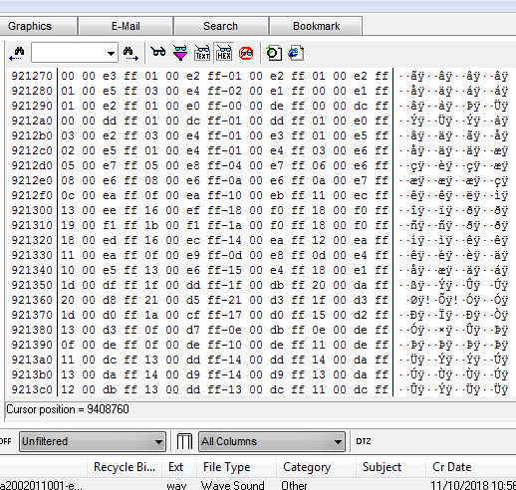
Steganalysis Continued 3
The Second form of method is to apply an analytical method using as many tools as possible to analyse the image. This is far more common requiring far less skill, expertise and experience. However it is the best way to build up experience to be able to carry out a blind analysis.
Here we see an example of Forensic Toolkit
being used to analyse the hex value of a file.
There are many such tools such as Autopsy.

Slide 12
Conclusion
It is very difficult to employ a blind analysis, which requires a great deal of skill, expertise and experience.
The best wat to increase the skills required to perform a blind analysis is to use the analytical method and use as many tools as possible, as often as possible to gain experience viewing signatures.
Tools need to be keep as up to date as possible to be sure that you have access to the latest database of hashes and signatures. Documentation must be thorough and software must be validated as acceptable for court use.

Slide 13
Contact Info
jamesfinglas@gmail.com
B00094138@student.itb.ie
https://www.linkedin.com/in/james-finglas-662b26171/

